Slide 1
Lecture 13
Poisson Process

Slide 2
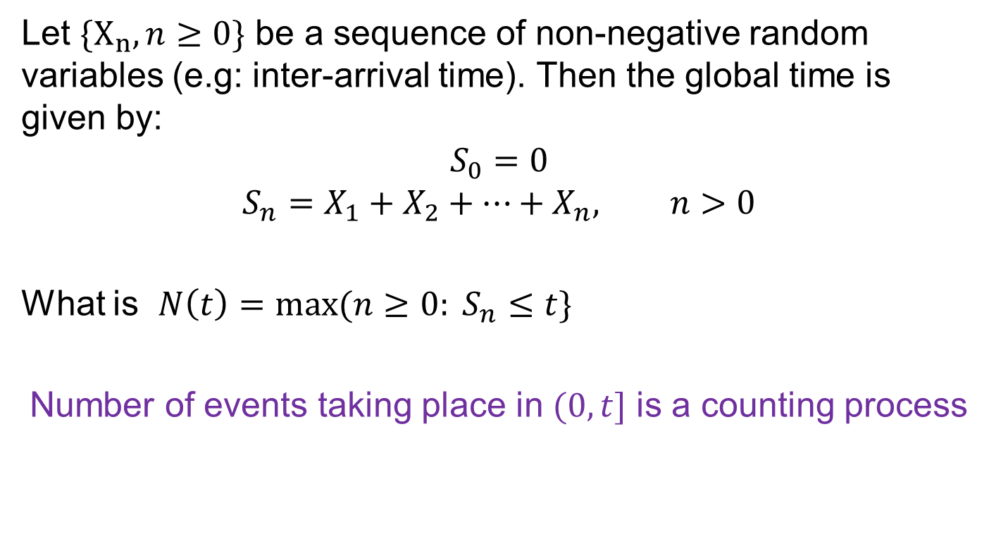
Counting Process
Let $\{X_{n}, n≥0\}$ be a sequence of non-negative random variables (e.g: inter-arrival time). Then the global time is given by:
$$S_{0}=0$$
$$S_{n}=X_{1}+X_{2}+…+X_{n}, n>0$$
What is $N\left(t\right)=max⁡(n≥0: S_{n}≤t\}$
Number of events taking place in $(0,t]$ is a counting process

Slide 3
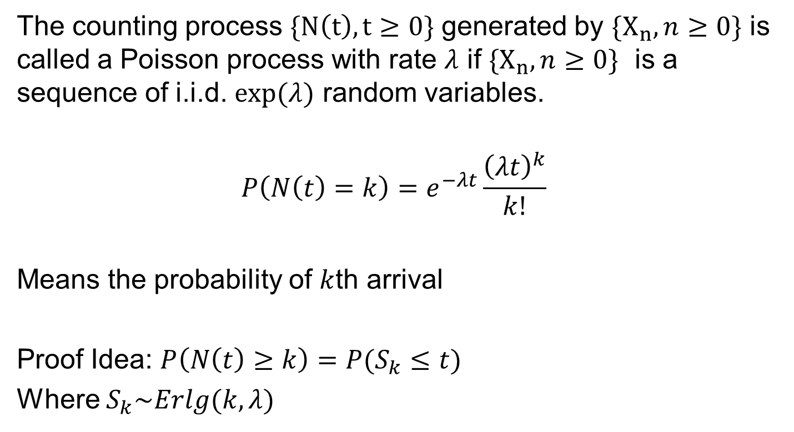
Poisson Process
The counting process $\{N\left(t\right), t≥0\}$ generated by $\{X_{n}, n≥0\}$ is called a Poisson process with rate $λ$ if $\{X_{n}, n≥0\}$ is a sequence of i.i.d. $exp⁡(λ)$ random variables.
$$P\left(N\left(t\right)=k\right)=e^{−λt}\frac{{\left(λt\right)}^{k}}{k!}$$
Means the probability of $k$th arrival
Proof Idea: $P\left(N\left(t\right)≥k\right)=P(S_{k}≤t)$
Where $S_{k}\sim Erlg(k,λ)$

Slide 4

Poisson Process - Proof
Proof Idea:
$$P\left(N\left(t\right)≥k\right)=P(S_{k}≤t)$$
Where $S_{k}\sim Erlg(k,λ)$
$$P\left(N\left(t\right)=k\right)=P\left(N\left(t\right)≥k\right)−P(N\left(t\right)≥k+1)$$
$=P\left(S_{k}≤t\right)−P(S_{k+1}≤t)$

Slide 5
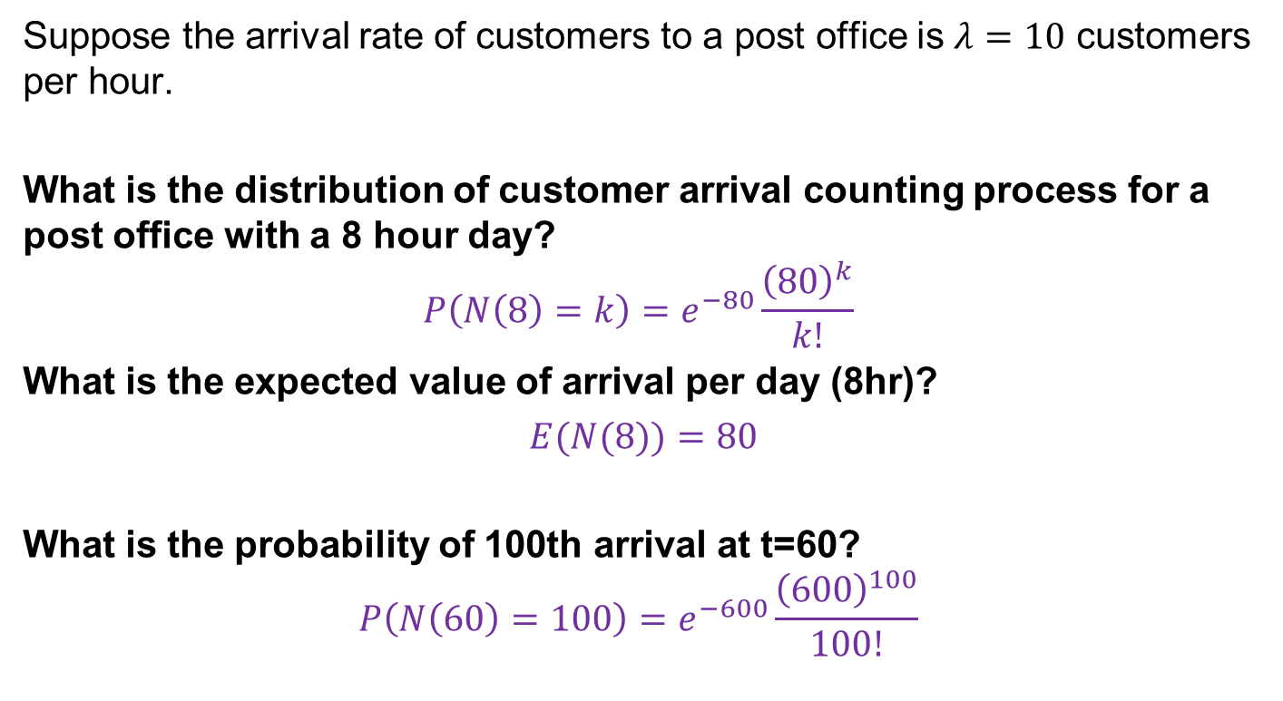
Example 1
Suppose the arrival rate of customers to a post office is $λ=10$ customers per hour.
What is the distribution of customer arrival counting process for a post office with a 8 hour day?
$$P\left(N\left(8\right)=k\right)=e^{−80}\frac{{\left(80\right)}^{k}}{k!}$$
What is the expected value of arrival per day (8hr)?
$E(N(8))=80$
What is the probability of 100th arrival at t=60?
$$P\left(N\left(60\right)=100\right)=e^{−600}\frac{{\left(600\right)}^{100}}{100!}$$

Slide 6
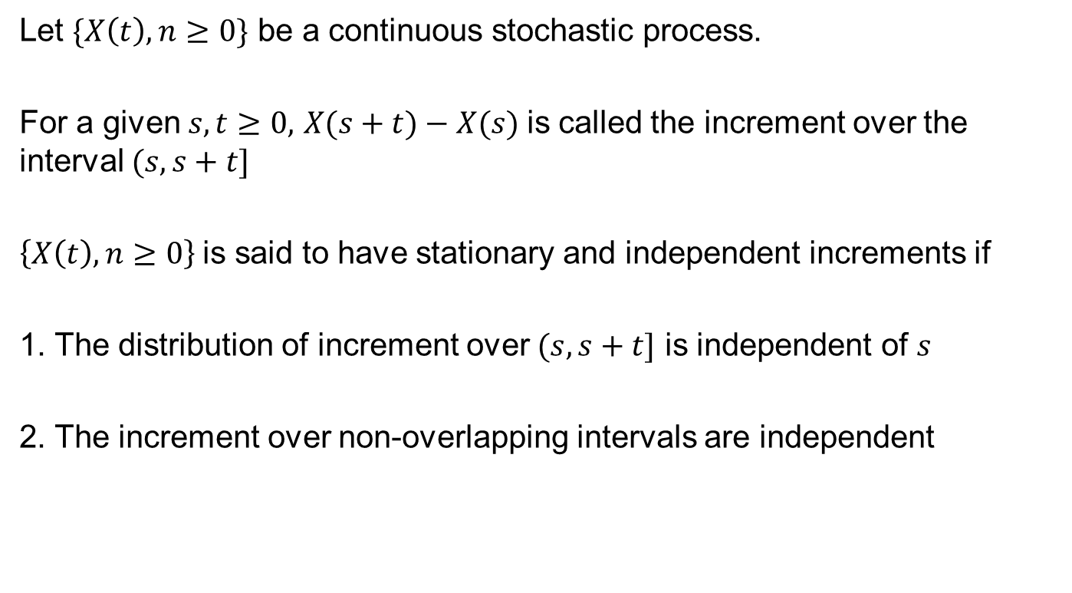
Stationary and Independent Increment
Let $\{X\left(t\right), n≥0\}$ be a continuous stochastic process.
For a given $s,t≥0,$ $X(s+t)−X(s)$is called the increment over the interval $(s, s+t]$
$\left\{X\left(t\right), n≥0\right\}$is said to have stationary and independent increments if
1. The distribution of increment over $(s, s+t]$ is independent of $s$
2. The increment over non-overlapping intervals are independent

Slide 7

Properties of Poisson Distribution
A Poisson process has stationary and independent increment property
Proof: Let $\left\{N\left(t\right), t≥0\right\}\sim PP(λ)$
$$P\left(N\left(t+s\right)−N\left(s\right)=k\right)=e^{−λt}\frac{{\left(λt\right)}^{k}}{k!}$$

Slide 8
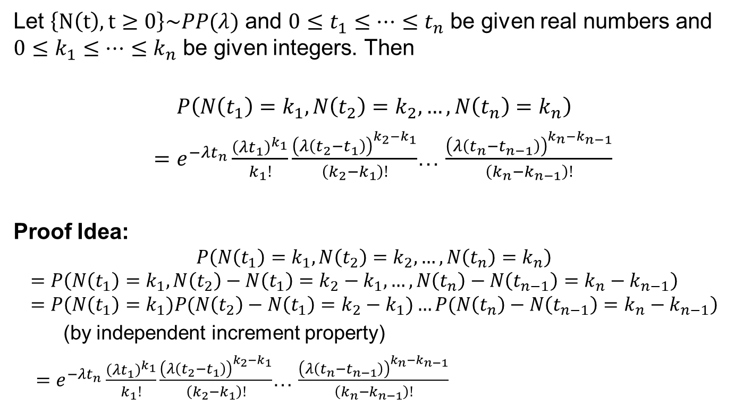
Finite Dimensional Distribution
Let $\left\{N\left(t\right), t≥0\right\}\sim PP(λ)$ and $0≤t_{1}≤…≤t_{n}$ be given real numbers and $0≤k_{1}≤…≤k_{n}$ be given integers. Then
$$P\left(N\left(t_{1}\right)=k_{1}, N\left(t_{2}\right)=k_{2},…,N\left(t_{n}\right)=k_{n}\right)$$
$=e^{−λt_{n}}\frac{{\left(λt_{1}\right)}^{k_{1}}}{k_{1}!}\frac{{\left(λ\left(t_{2}−t_{1}\right)\right)}^{k_{2}−k_{1}}}{\left(k_{2}−k_{1}\right)!}$… $\frac{{\left(λ\left(t_{n}−t_{n−1}\right)\right)}^{k_{n}−k_{n−1}}}{\left(k_{n}−k_{n−1}\right)!}$
Proof Idea:
$$P\left(N\left(t_{1}\right)=k_{1}, N\left(t_{2}\right)=k_{2},…,N\left(t_{n}\right)=k_{n}\right)$$
$$=P\left(N\left(t_{1}\right)=k_{1}, N\left(t_{2}\right)−N\left(t_{1}\right)=k_{2}−k_{1},…,N\left(t_{n}\right)−N\left(t_{n−1}\right)=k_{n}−k_{n−1}\right)=P\left(N\left(t_{1}\right)=k_{1})P(N\left(t_{2}\right)−N\left(t_{1}\right)=k_{2}−k_{1})…P(N\left(t_{n}\right)−N\left(t_{n−1}\right)=k_{n}−k_{n−1}\right)$$
(by independent increment property)
$=e^{−λt_{n}}\frac{{\left(λt_{1}\right)}^{k_{1}}}{k_{1}!}\frac{{\left(λ\left(t_{2}−t_{1}\right)\right)}^{k_{2}−k_{1}}}{\left(k_{2}−k_{1}\right)!}$… $\frac{{\left(λ\left(t_{n}−t_{n−1}\right)\right)}^{k_{n}−k_{n−1}}}{\left(k_{n}−k_{n−1}\right)!}$

Slide 9
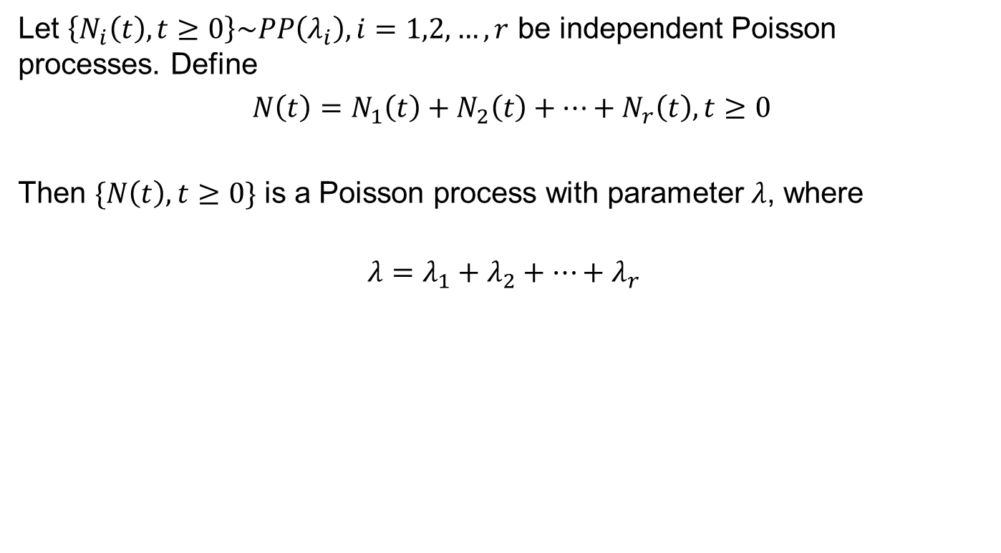
Superposition of Poisson Distribution
Let $\left\{N_{i}\left(t\right), t≥0\right\}\sim PP\left(λ_{i}\right), i=1,2,…,r$ be independent Poisson processes. Define
$N\left(t\right)=N_{1}\left(t\right)+N_{2}\left(t\right)+…+N_{r}\left(t\right), t≥0$
Then $\{N\left(t\right), t≥0\}$ is a Poisson process with parameter $λ$, where
$$λ=λ_{1}+λ_{2}+…+λ_{r}$$

Slide 10
Example 1
The customer arrival process at a post office is PP(10 customer/hr). What is the probability that one customer arrives between 1:00 pm and 1:06 pm and two customers arrive between 1:03 pm and 1:12 pm?
Ans: First, we need to convert all time intervals from minutes to hours. e.g. (1:06-1:00)/60=0.1 hour

Slide 11
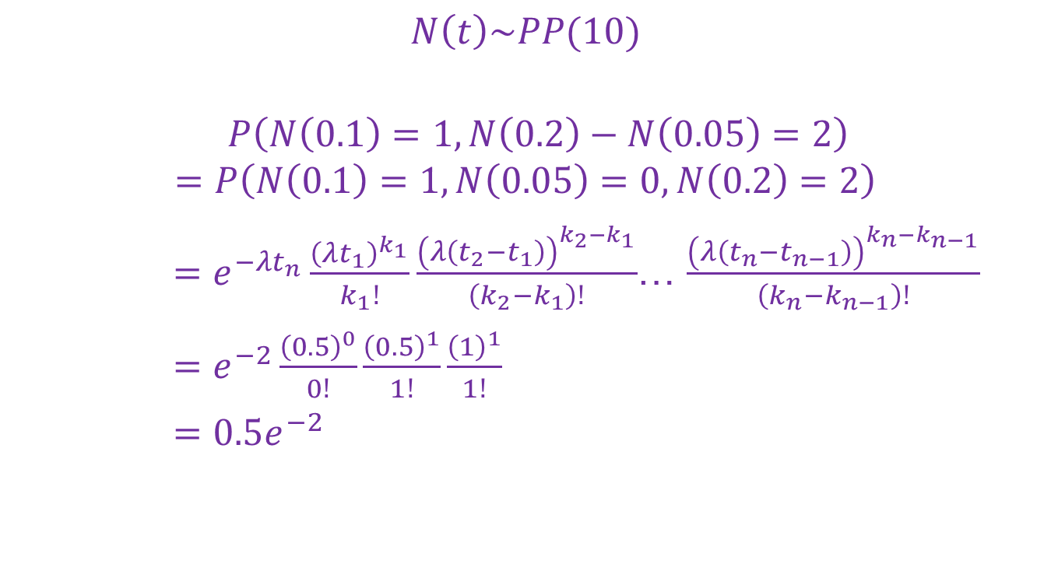
Example 1 - Solution
$$N\left(t\right)\sim PP(10)$$
$$P\left(N\left(0.1\right)=1, N\left(0.2\right)−N\left(0.05\right)=2\right)$$
$$=P\left(N\left(0.1\right)=1, N\left(0.05\right)=0,N\left(0.2\right)=2\right)$$
$=e^{−λt_{n}}\frac{{\left(λt_{1}\right)}^{k_{1}}}{k_{1}!}\frac{{\left(λ\left(t_{2}−t_{1}\right)\right)}^{k_{2}−k_{1}}}{\left(k_{2}−k_{1}\right)!}$… $\frac{{\left(λ\left(t_{n}−t_{n−1}\right)\right)}^{k_{n}−k_{n−1}}}{\left(k_{n}−k_{n−1}\right)!}$
$=e^{−2}\frac{{\left(0.5\right)}^{0}}{0!}\frac{{\left(0.5\right)}^{1}}{1!}\frac{{\left(1\right)}^{1}}{1!}$
$={0.5e}^{−2}$

Slide 12
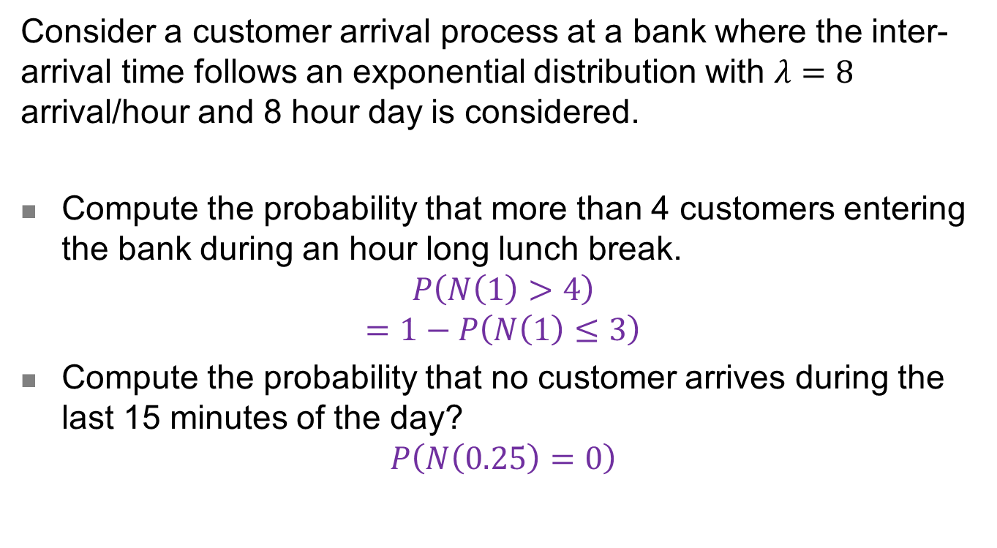
Example 2
Consider a customer arrival process at a bank where the inter-arrival time follows an exponential distribution with $λ=8$ arrival/hour and 8 hour day is considered.
Compute the probability that more than 4 customers entering the bank during an hour long lunch break.
$$P\left(N\left(1\right)>4\right)$$
$$=1−P\left(N\left(1\right)≤3\right)$$
Compute the probability that no customer arrives during the last 15 minutes of the day?
$$P\left(N\left(0.25\right)=0\right)$$

Slide 13
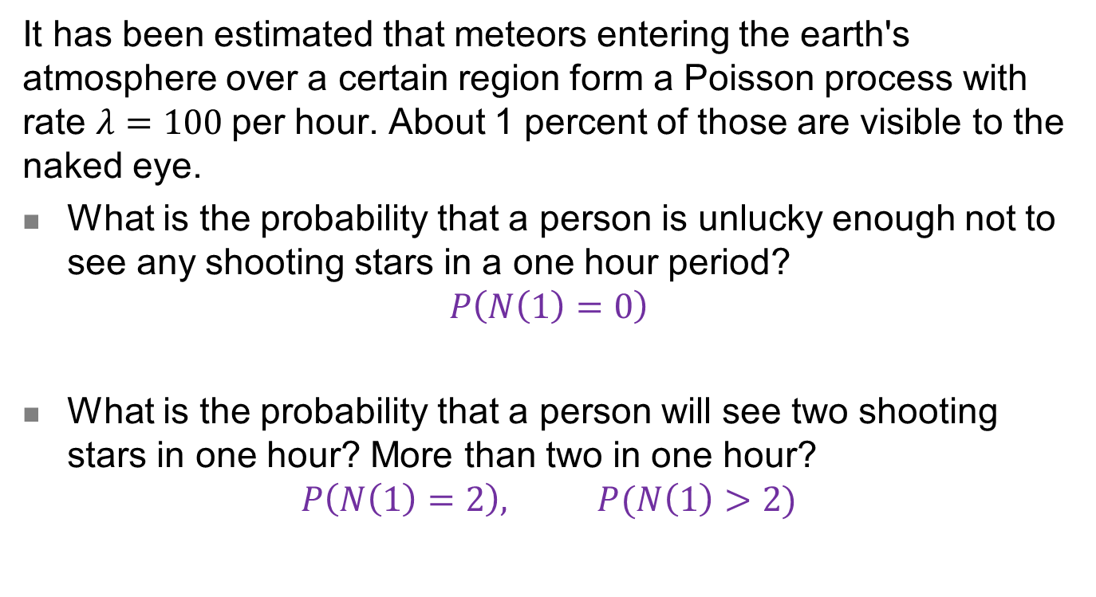
Example 3
It has been estimated that meteors entering the earth's atmosphere over a certain region form a Poisson process with rate $λ=100$per hour. About 1 percent of those are visible to the naked eye.
What is the probability that a person is unlucky enough not to see any shooting stars in a one hour period?
$$P\left(N\left(1\right)=0\right)$$
What is the probability that a person will see two shooting stars in one hour? More than two in one hour?
$$P\left(N\left(1\right)=2\right), P(N\left(1\right)>2)$$

